Slide 1
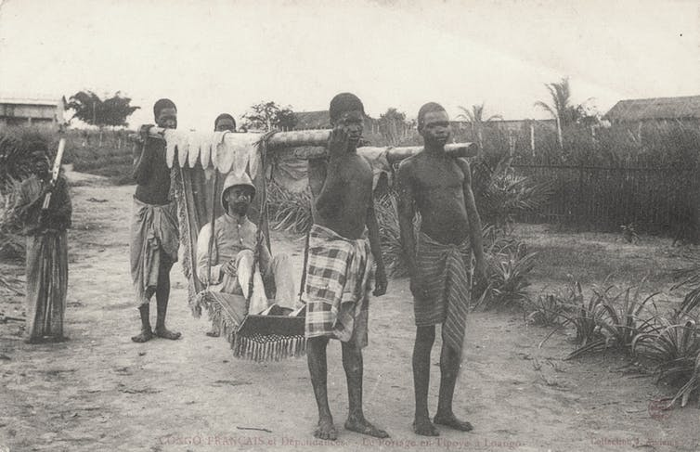
The Colonization of Africa part 2
European Conquest and Rule
Late 1800s into the 1900s

Slide 2
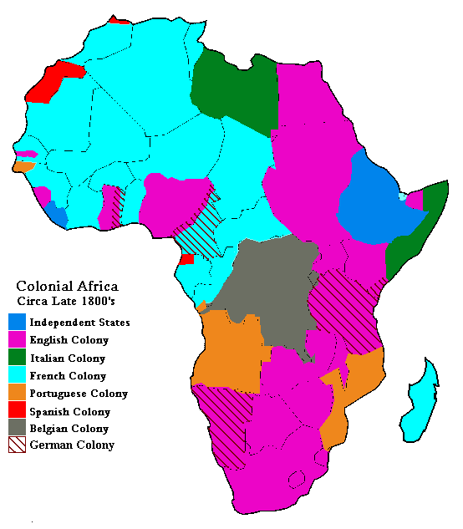
Notes:
http://mama.indstate.edu/users/geboen/ch3_afrcol.gif
mama.indstate.edu/ users/geboen/ch3_s00.html

Slide 3
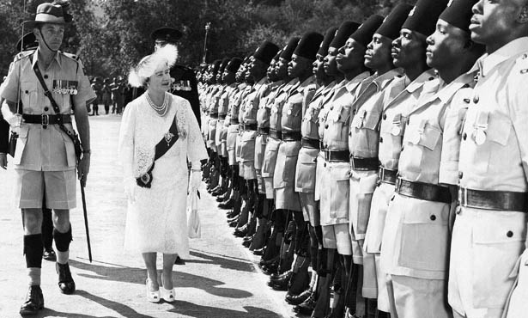
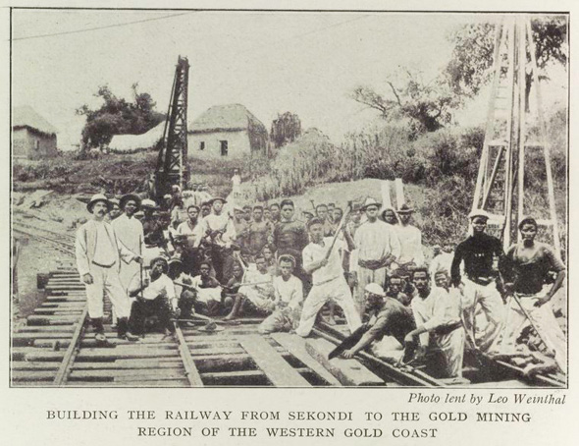
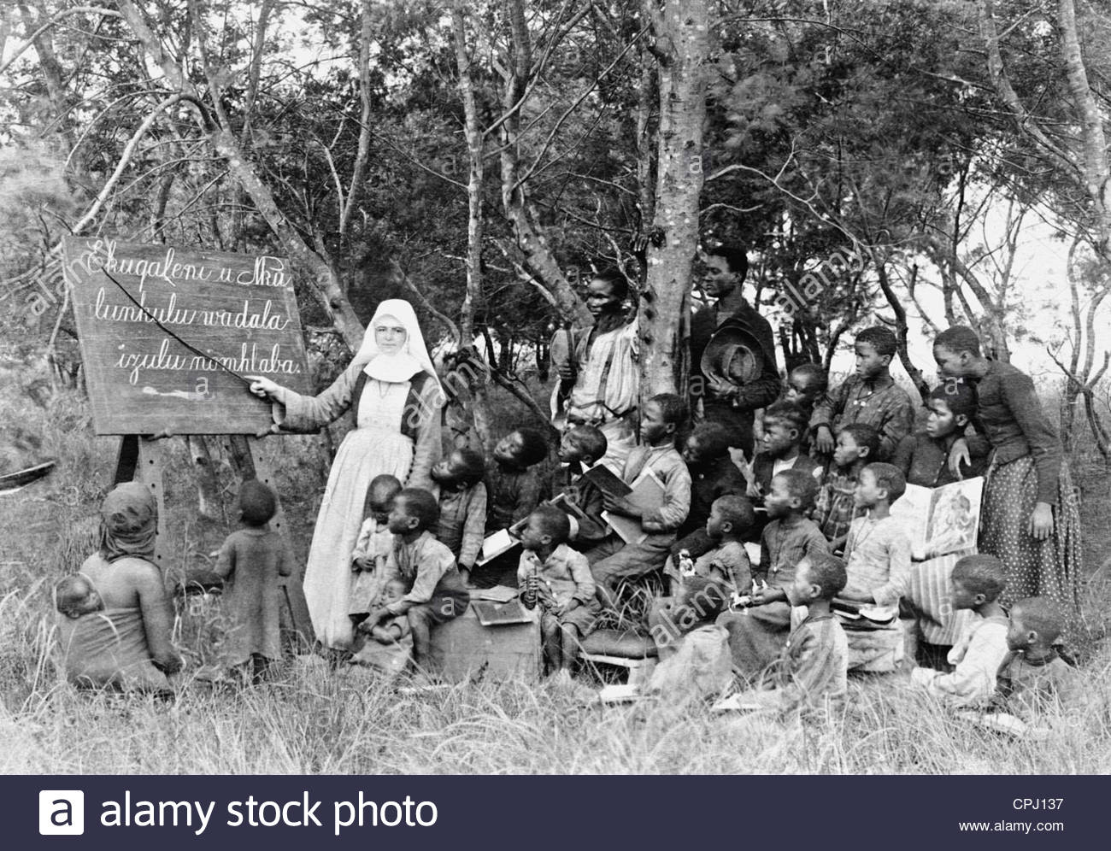
Colonial rule means
Domination through political, economic and cultural means

Slide 4
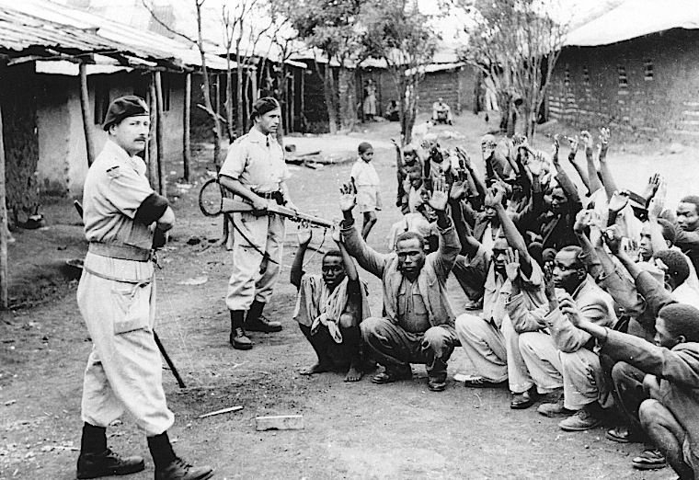
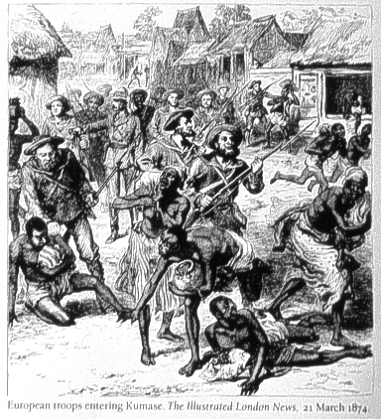
Colonial rule (cont)
forcibly imposed
Through military strength.
(British in Ghana)
Caption reads: European Troops enter
Kumase (London Times, illust. 1874)

Slide 5
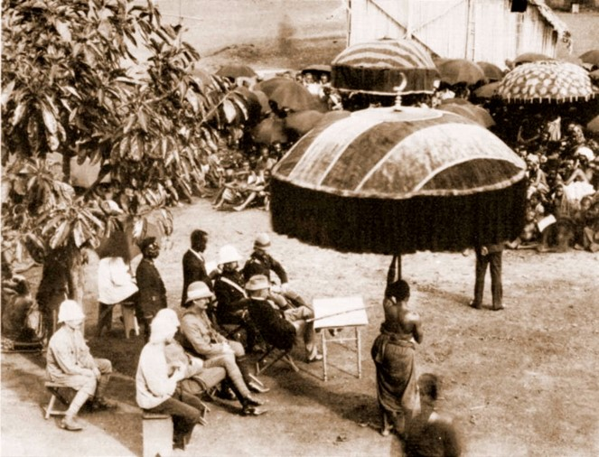
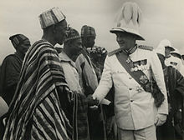
Policies and structures of the colonial state
The process of occupation, however was initiated and sustained violently either through military conquest
or by bribing and involving local chiefs.
Policies and structures of each colonial state varied, and mostly reflected the political climate at home.

Slide 6
Principle of Effectivity
powers could hold colonies only if they actually possessed them
in other words, if they had treaties with local leaders, if they flew their flag there, and if they established an administration in the territory to govern it with a police force to keep order

Slide 7
Principle of Effectivity (cont)
colonial power also had to make use of the colony economically.
If the colonial power did not do these things, another power could do so and take over the territory.
It therefore became important to get leaders to sign a protectorate treaty and to have a presence sufficient to police the area.

Slide 8
questions
In general, what were the political and economic reasons behind European colonization of Africa?

Slide 9
Factors fueling European colonies overseas
Political factors:
Economic factors:
Rivalries and balance of power between leading European nations at the time.
A quest for one’s national status and fame
These factors helped to create an interest in having colonies overseas
The desire to acquire and control new markets
Initially the occupation of African territories
was a measure to protect sea routes to the Middle East and Asia
An interest in land acquisition and raw materials developed later

Slide 10
questions
In contrast to these practical concerns, what kinds of so called moral, “noble” reasons and/or in other words “racist ideologies” that helped to provide “justification” for the colonization of Africa?

Slide 11
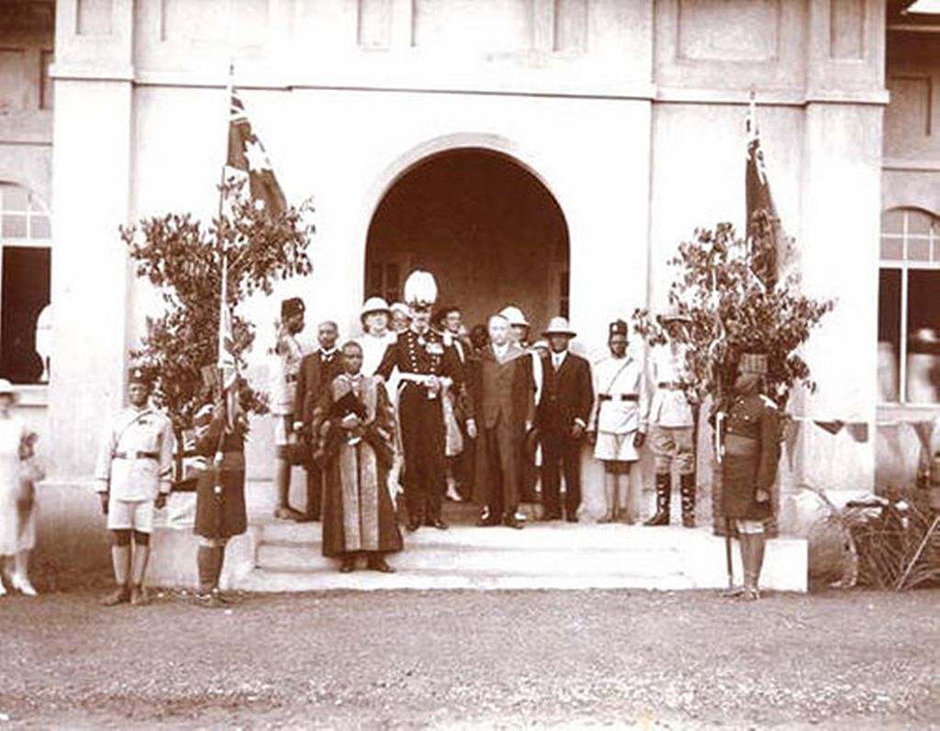
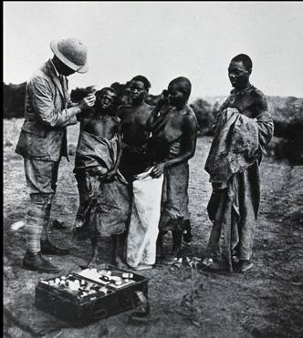
Europeans portrayed themselves as liberators
“The white man’s burden”
Civilizing the natives
Educating
Bringing modern medicines

Slide 12
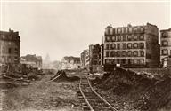
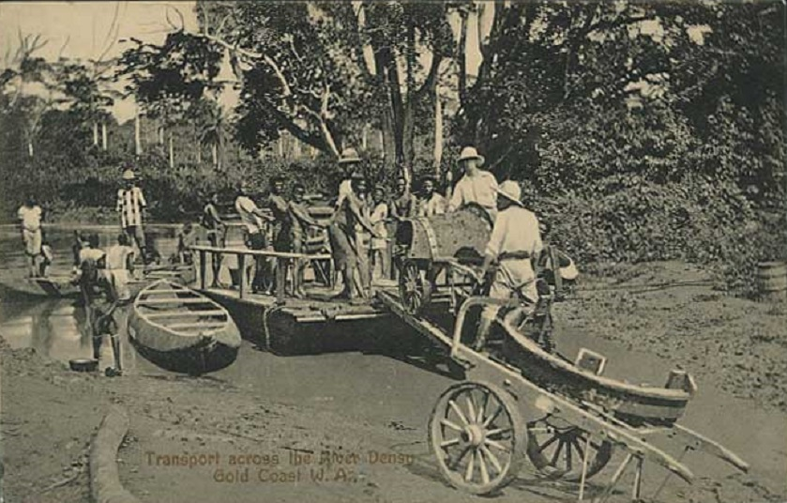
problems due to colonial rule
Many Africans were forced to be laborers for building infrastructure [Imposed slave labor}
1800s -1900s Ghana (left) and Nigeria (below)

Slide 13
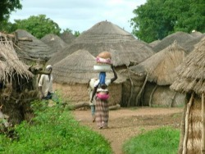
Other problems for African people due to Colonial rule
Led to new ethnic, gender and class relationships in which they were pitted against each other
Disrupted pre-colonial relationships in trade and times of peace
Abolished or disempowered existing structures of government or indigenous authority
Changed ways of growing food, Europeans wanted to raise crops and round up goods for export to Europe
Notes:
Photos: Village in Ghana
“Ghana: Colonization and Struggle for Independence” fron Ghana by John Barnard, Avery Hansen, Nathan Rice and Teddy Verbockel
http://hj2009per6ghana.weebly.com/uploads/2/2/4/6/2246136/7803681.jpg
accessed on September 28, 2011.

Slide 14
Disrupted pre-colonial relations
Status of women declined (previously were chiefs, village leaders, officials, led political councils etc.)
Women also lost access to land and labor
Eliminated certain social structures such as castes
Artisans saw a decline in their economic status
Undermined formerly wealthy African rulers
Opportunities for social mobility became few

Slide 15
Problems endure
New geographic boundaries and ethnic identities emerged where none had been before
same ethnic divisions contributed to civil wars many years later

Slide 16
Animated Maps
http://www.lasalle.edu/~mcinneshin/344/week11.htm
Explore the chronology of the “take over” of Africa on this interactive website.
Notes:
Explore the chronology of the take over of Africa

Slide 17
Colonialism in Africa
Colonialism in Africa 3:2 min.
http://www.youtube.com/watch?v=47wyvMv5ba8&feature=related

